Slide 1


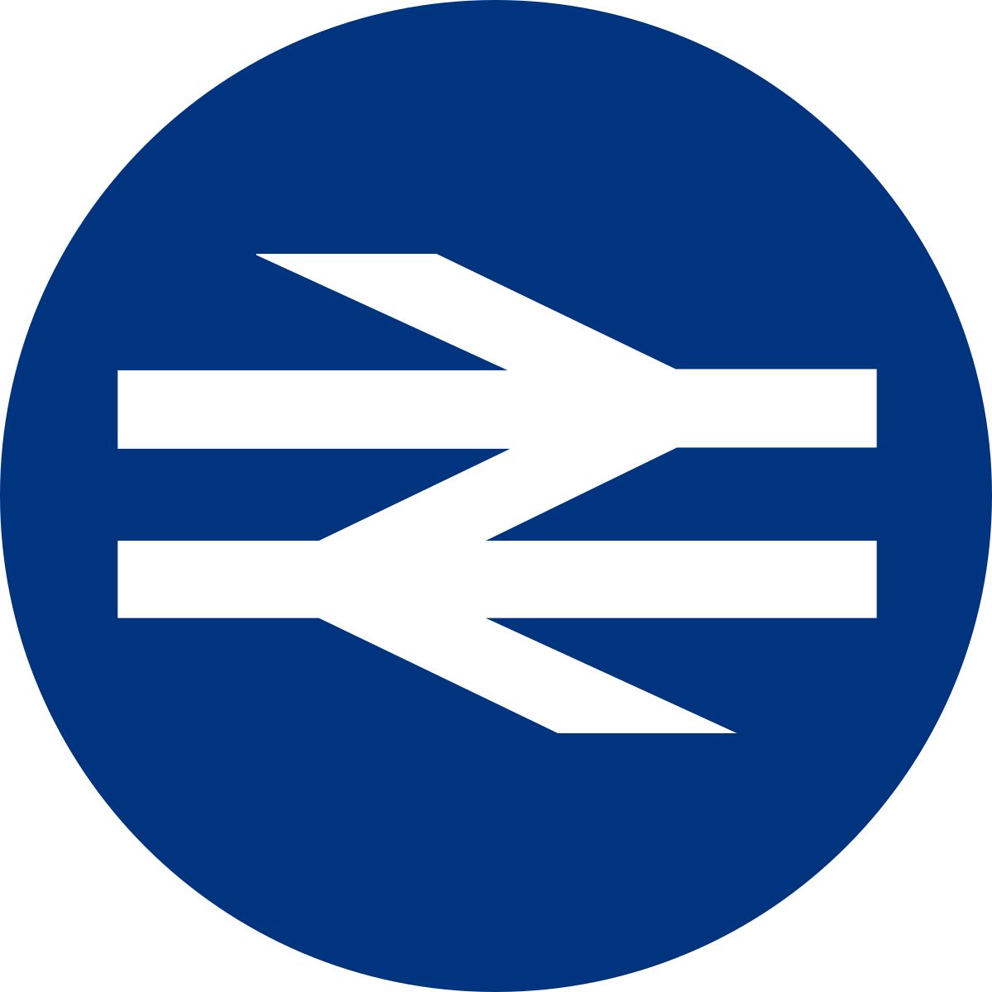
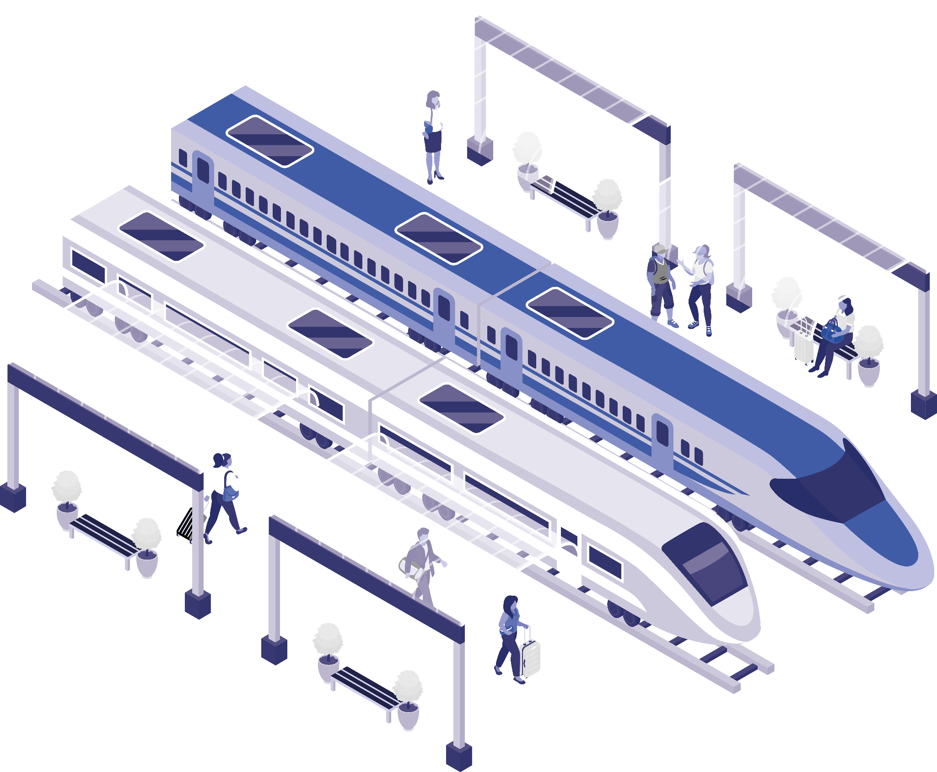
UK NATIONAL RAIL PERFORMANCE 2024

Slide 2

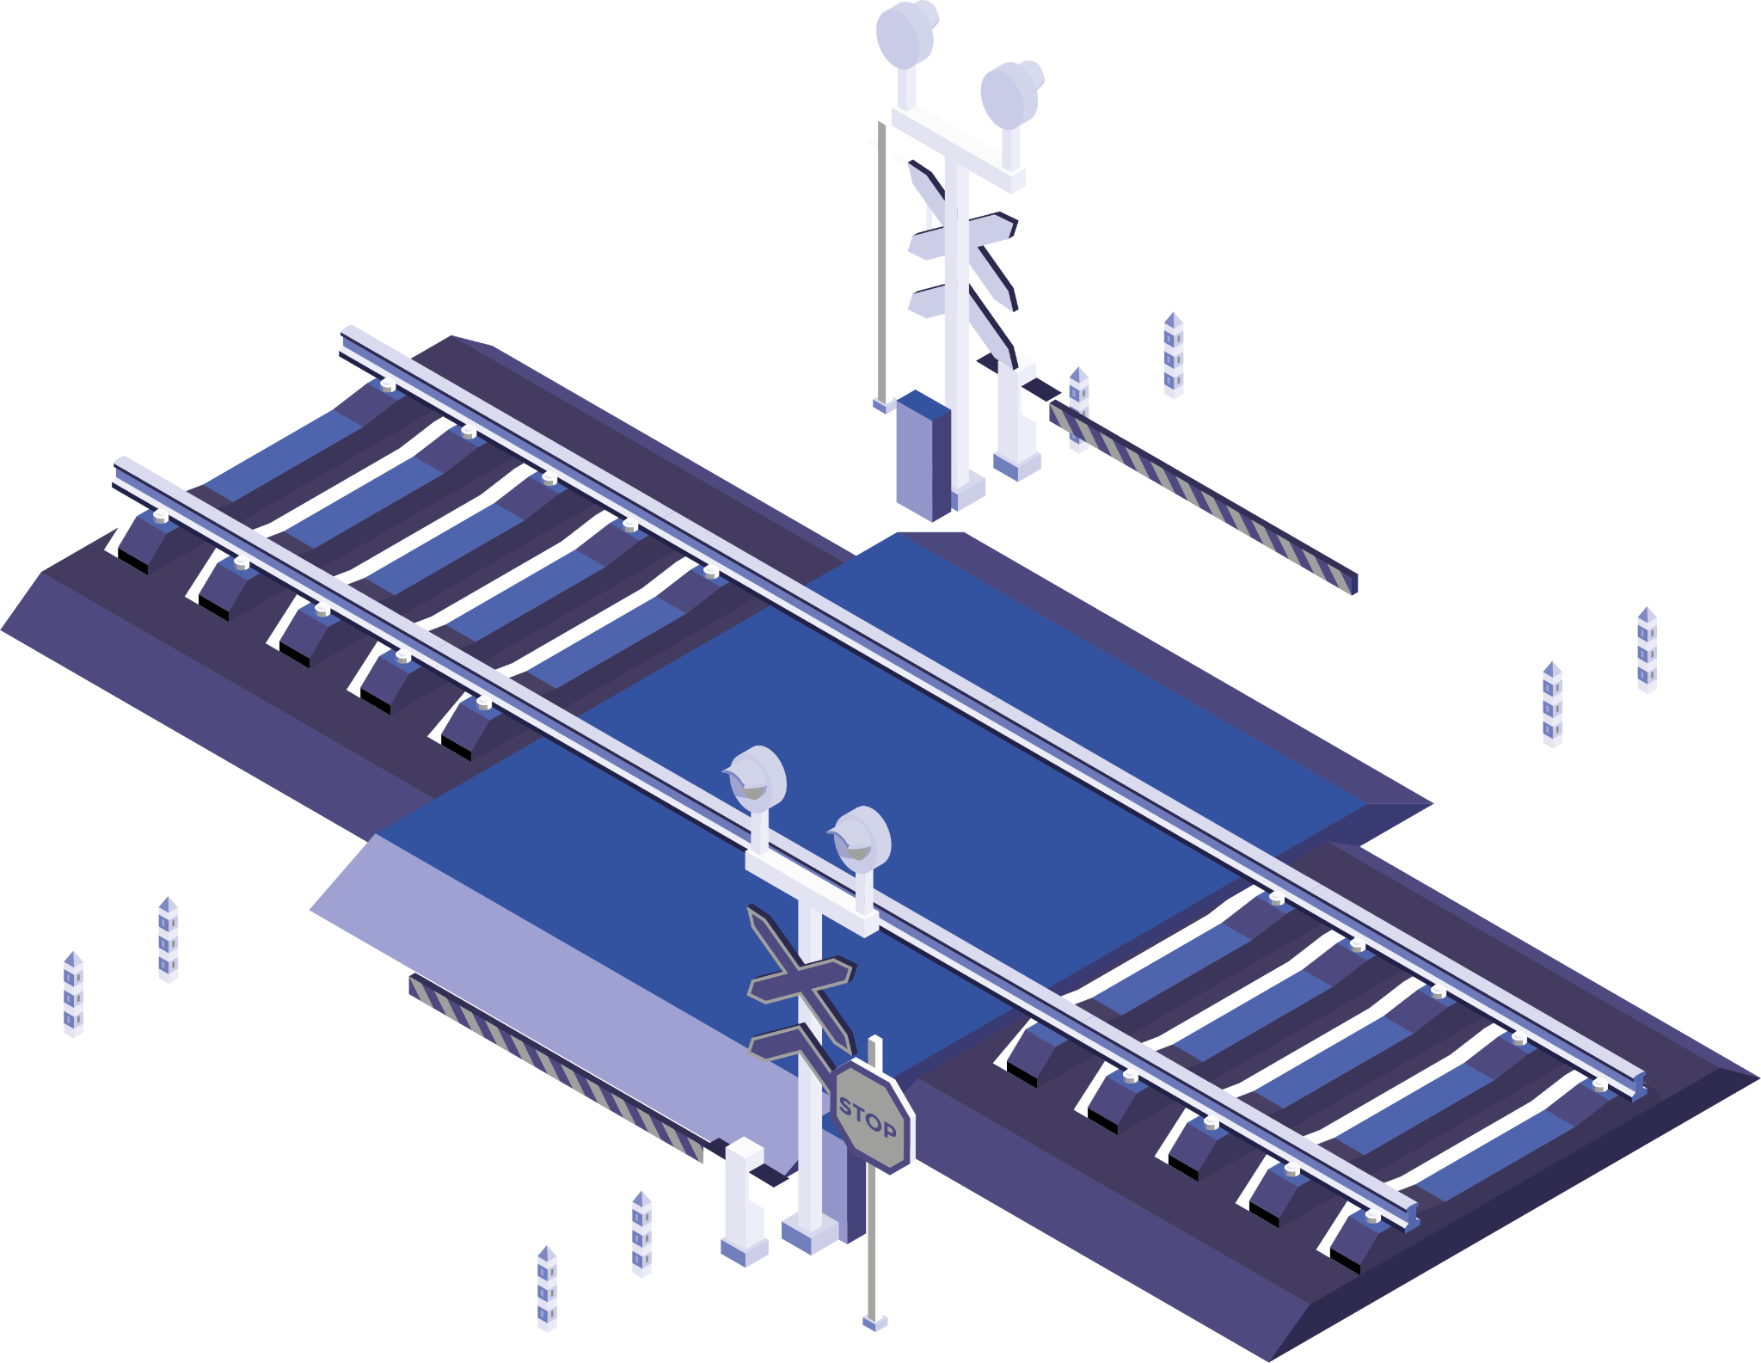
Agenda
01
02
03
04
Meet the Team
Background
Business Problem
Approach and Insights
05
Conclusion

Slide 3

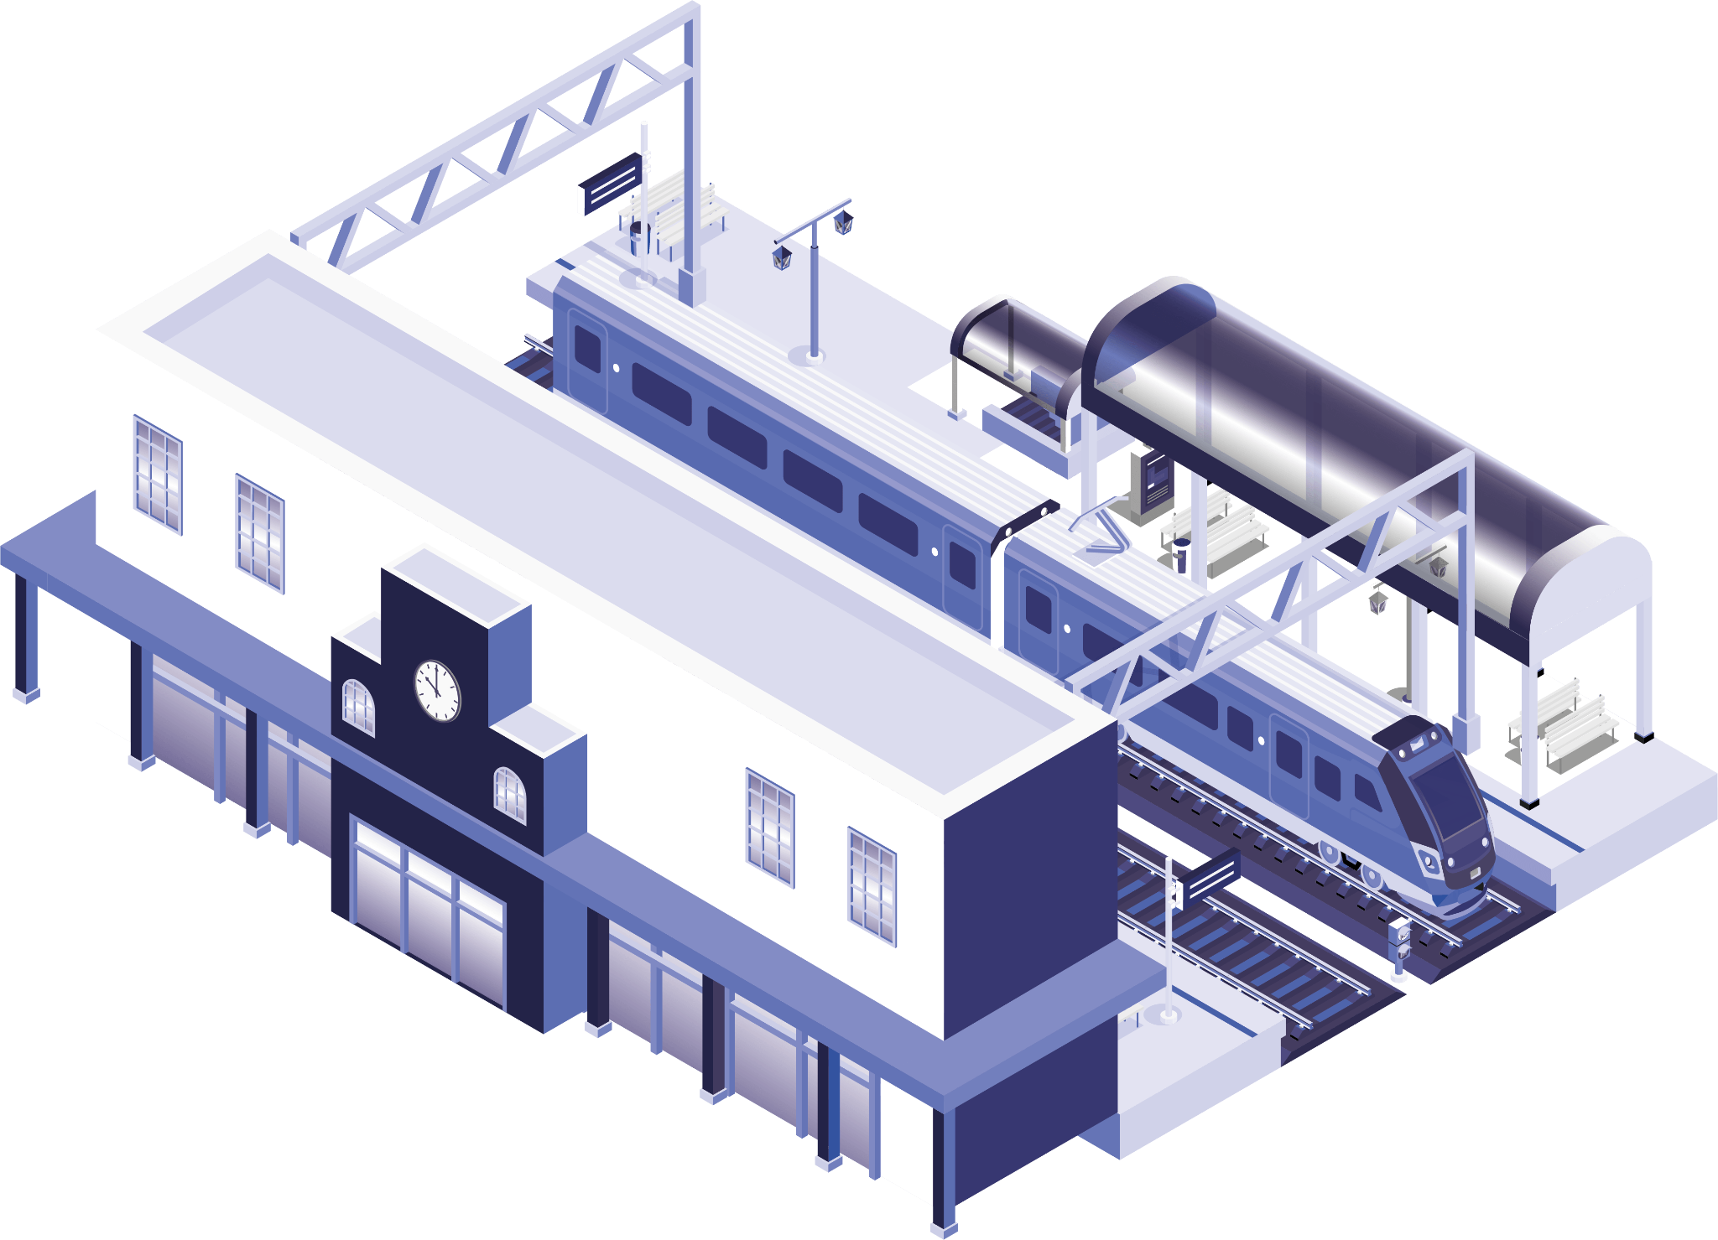
Meet the Team
Brian Levesque
Ilackkeya Bhavananthi
Osman Nayeem

Slide 4

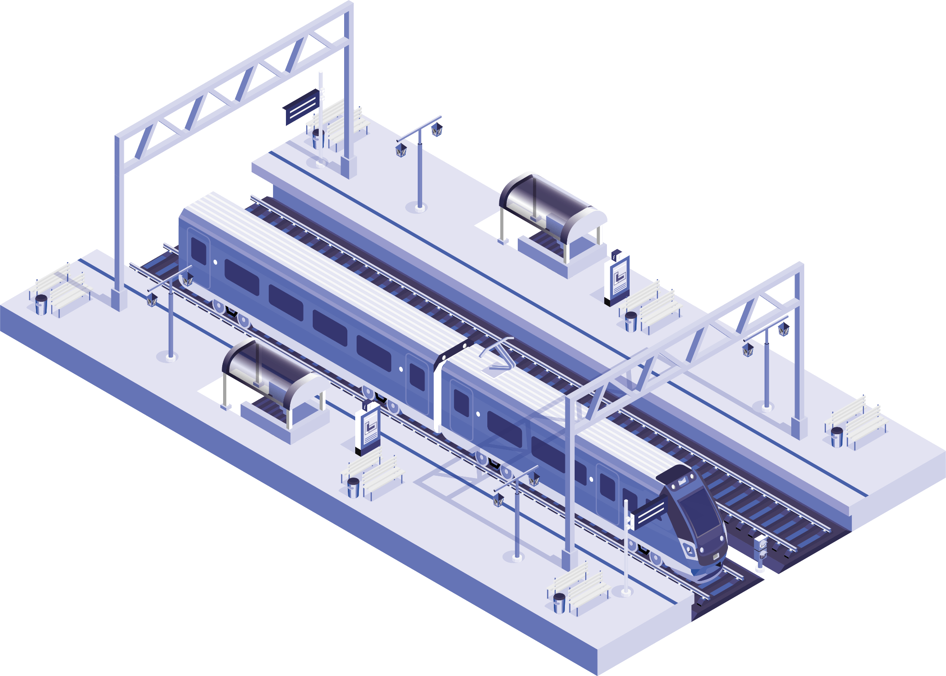
Background
The UK rail network's origins trace back to the 19th century, with the first intercity rail pioneering Liverpool-Manchester Railway debuting in 1830.
Networked over 20,000 miles of track and serves around 2,500 stations in the UK.
Approximately 1.8 billion passenger journeys per year (pre-pandemic levels).
Currently managed by various train operating companies (TOCs) under franchises awarded by the government.
Network Rail oversees infrastructure maintenance and improvements.
Source: ORR | Network Rail | National Rail

Slide 5

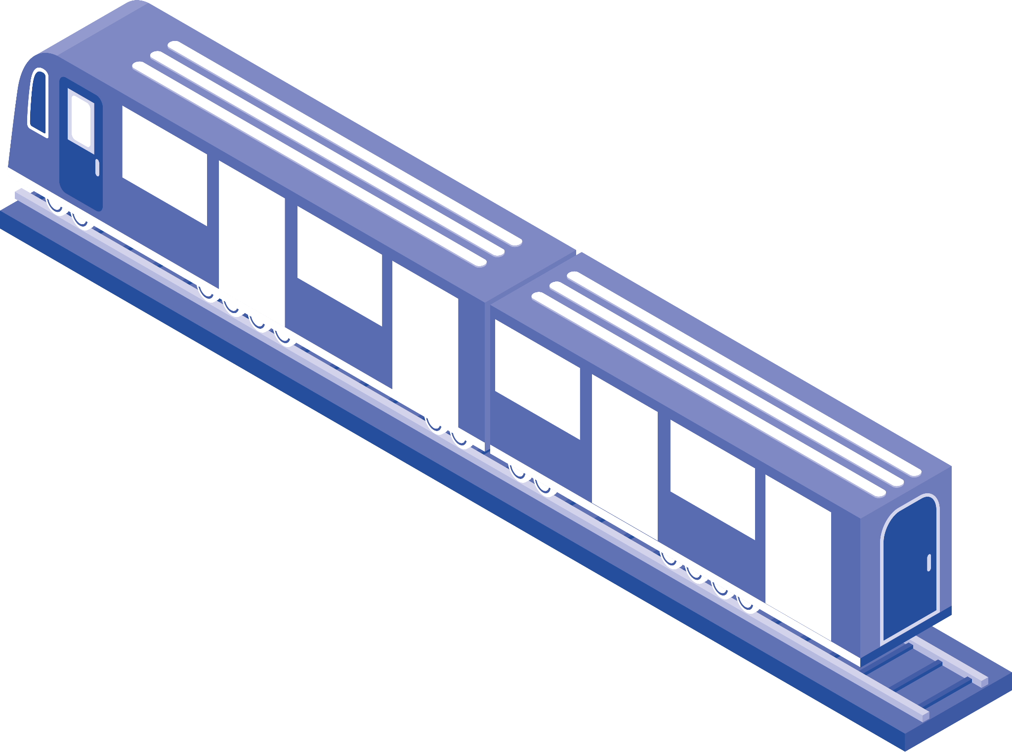
Business Problem
PROBLEM STATEMENT Current Board of UK National Railways – Schedule performance overview, Delay Compensation efficiency by TOCs and Delay prediction model
As Data Analysts, our team has following questions to answer:
Where and How to get the data?
What is in our data?
What are we going to answer?
Are the trains delayed?
How long the trains are delayed?
When is the delay observed?
Who is causing more delays?
And more…….
Can we predict if the train is going to be delayed?

Slide 6


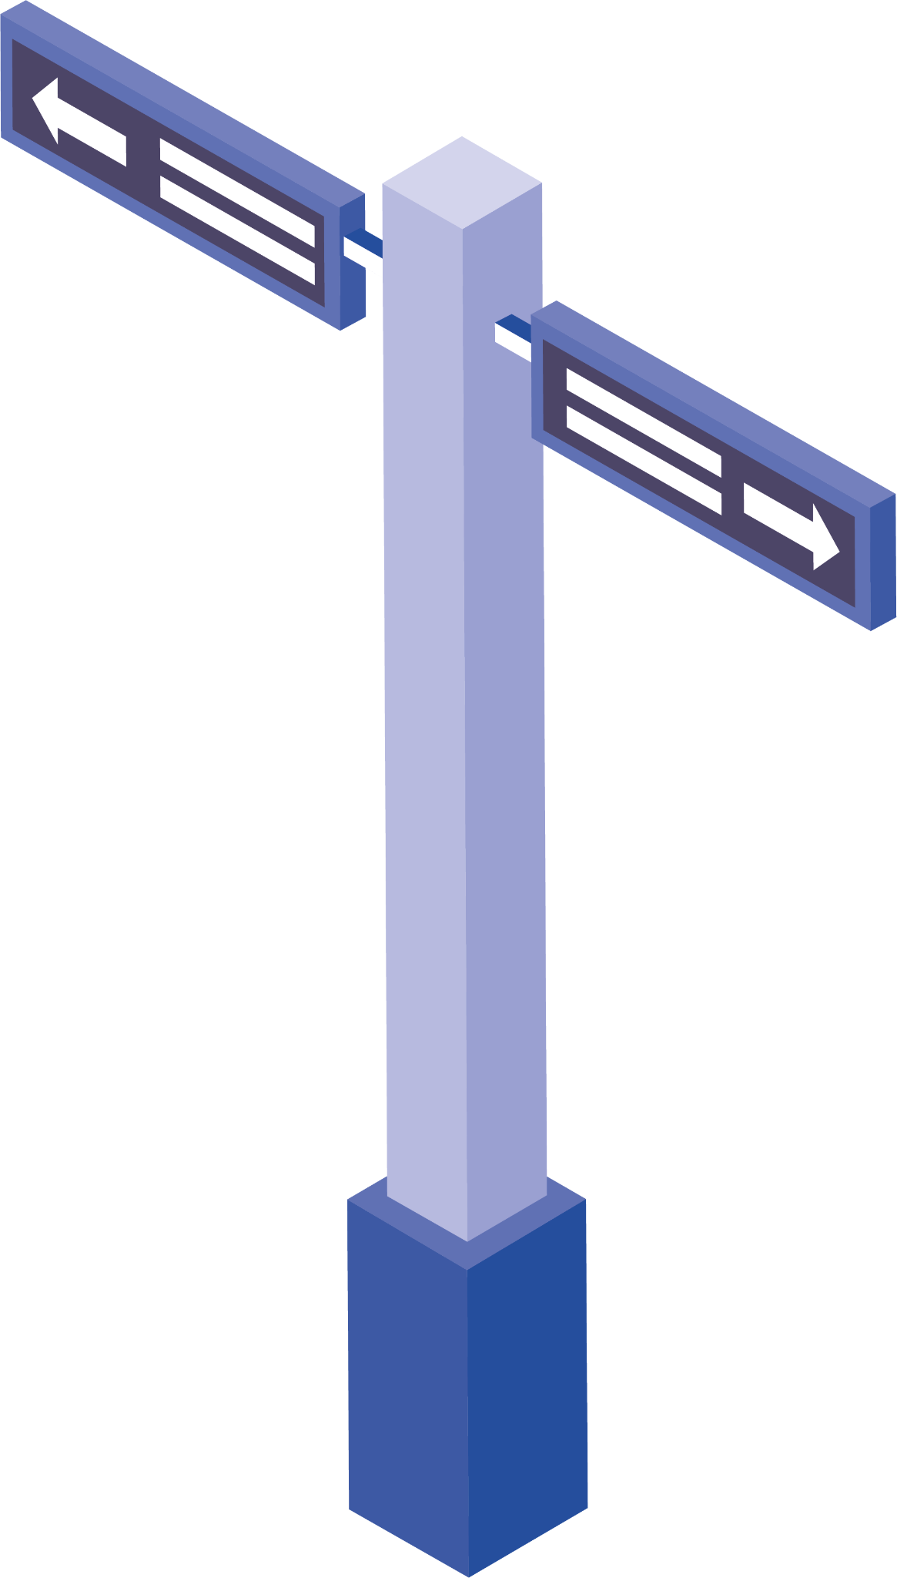
Approach and Insights
Where and How to get the data?
1
6
Process and load to DB
Containerize Docker Images
2
5
Consume the live data
Start the pipeline
3
4
Fetch Live data

Slide 7
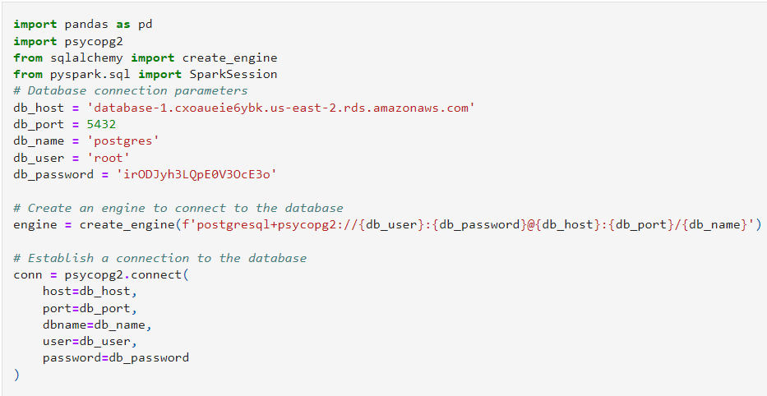
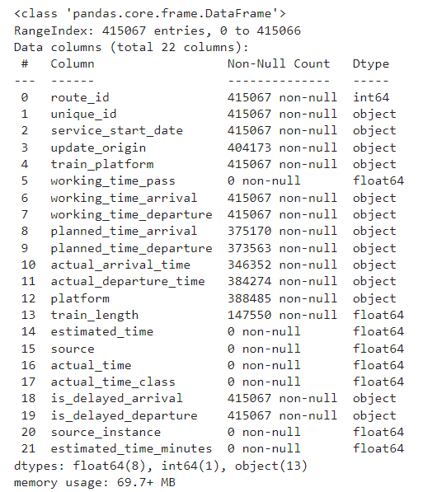
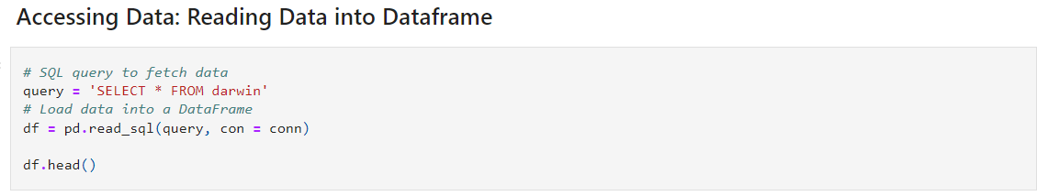
Approach and Insights
What is in our data?

Slide 8
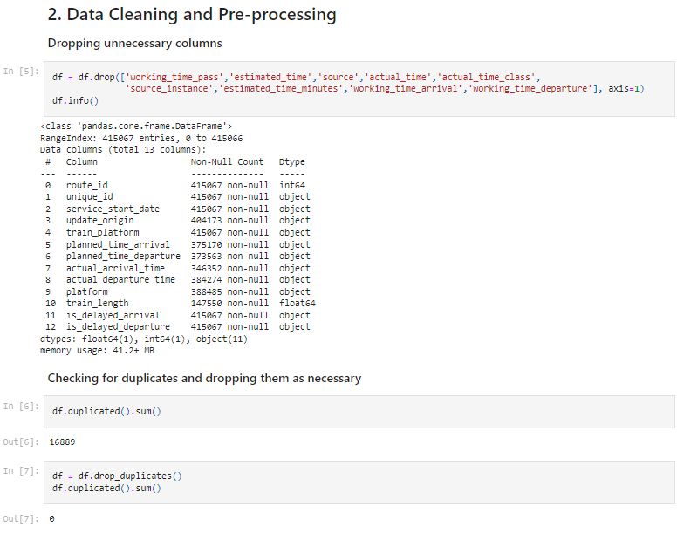
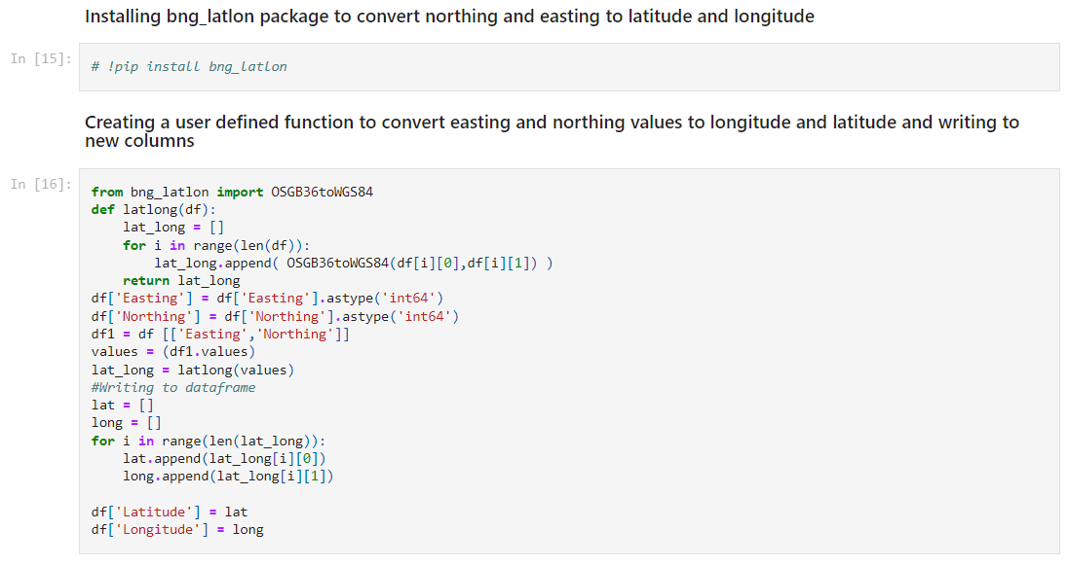
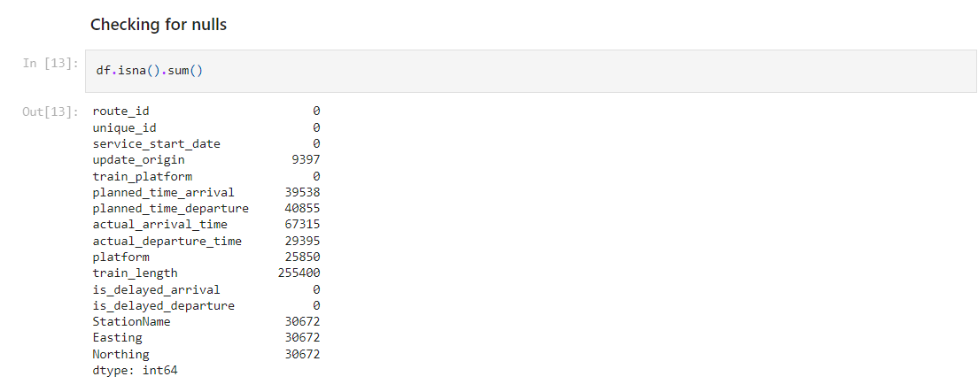
Approach and Insights

Slide 9
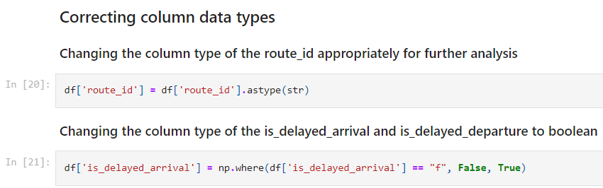
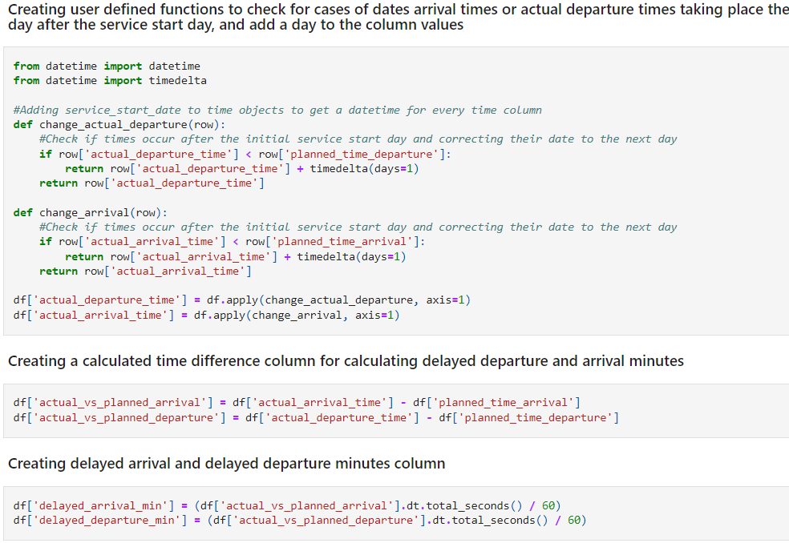
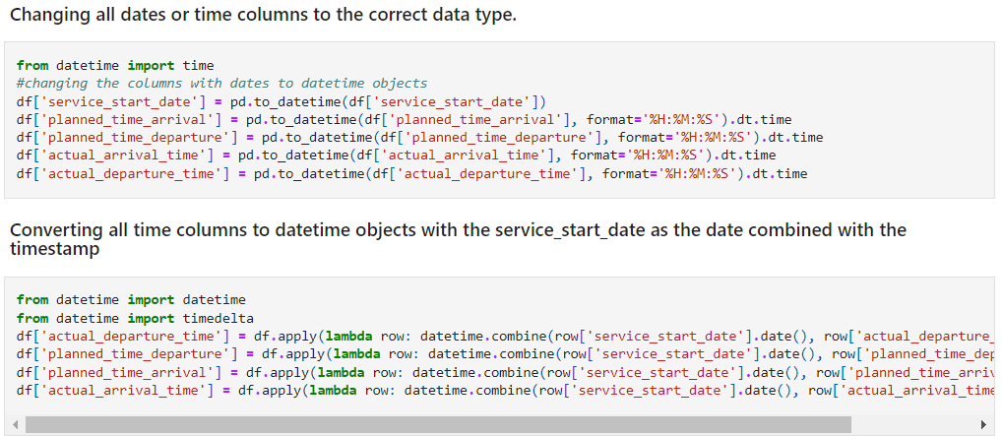
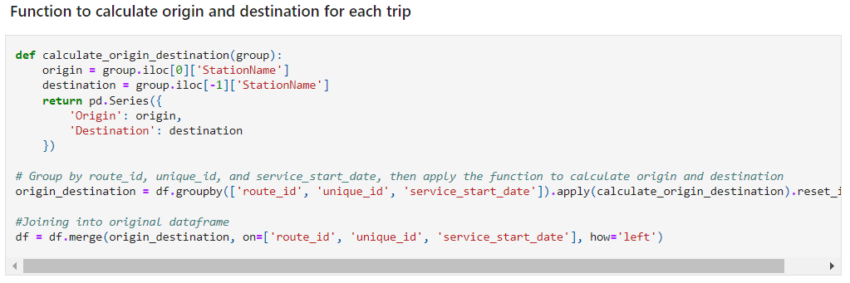
Approach and Insights

Slide 10
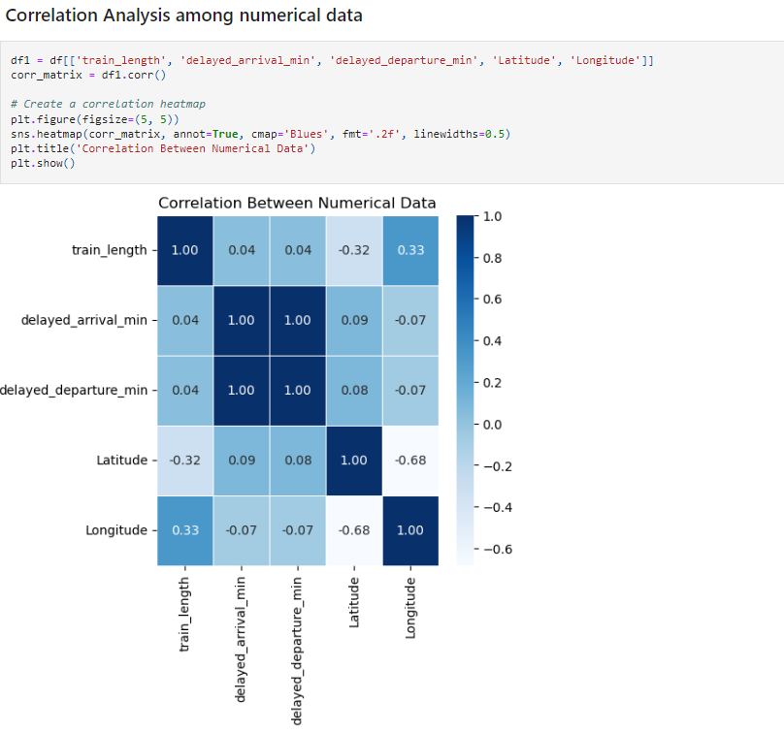
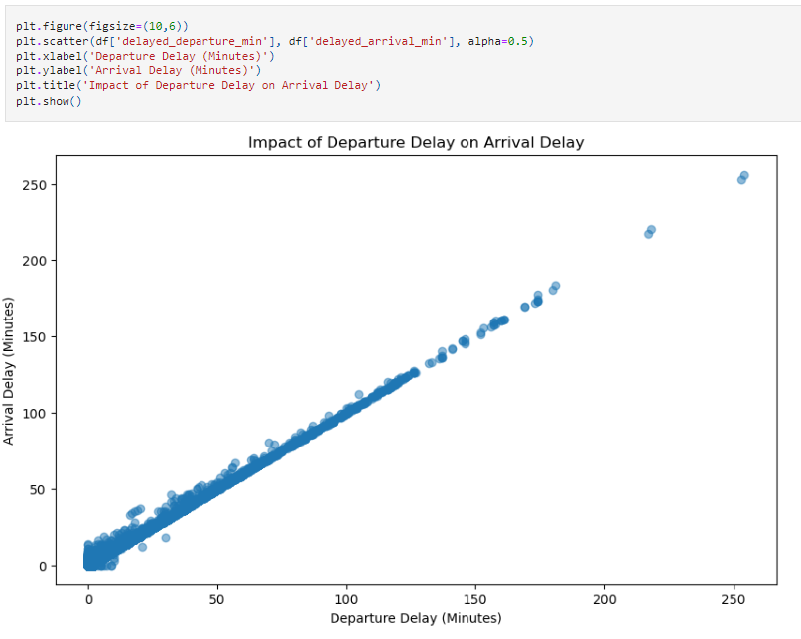
Approach and Insights
What are we going to answer?

Slide 11
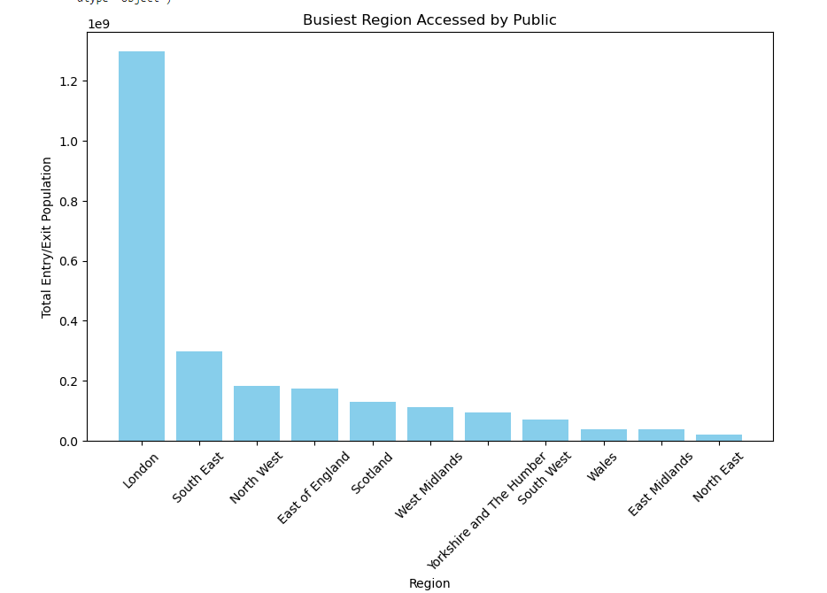
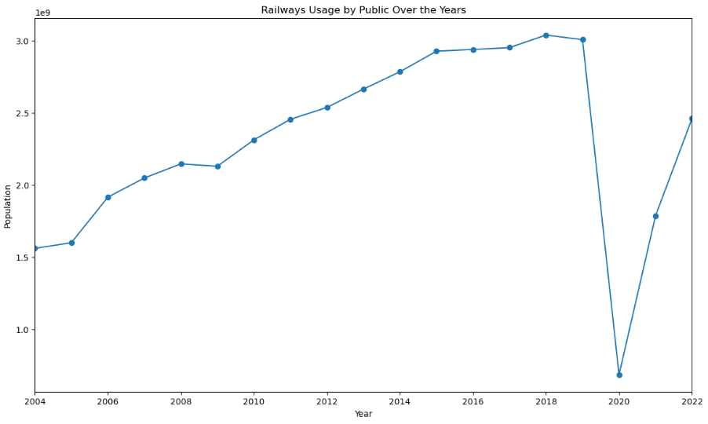
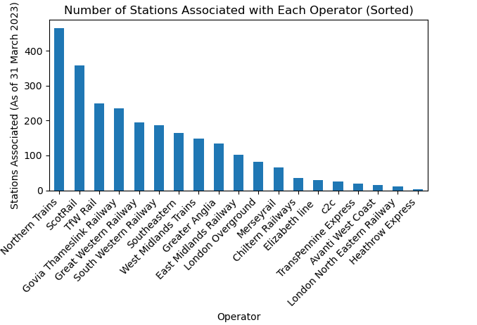
Approach and Insights
What are we going to answer?

Slide 12
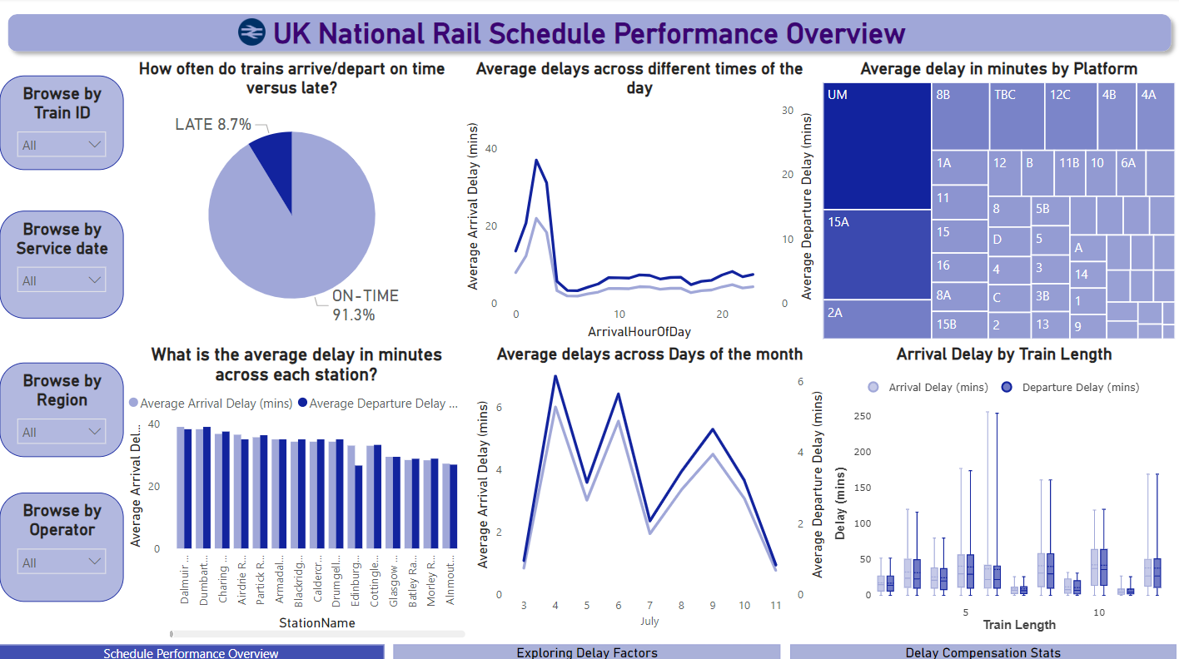
Approach and Insights
What are we going to answer?

Slide 13
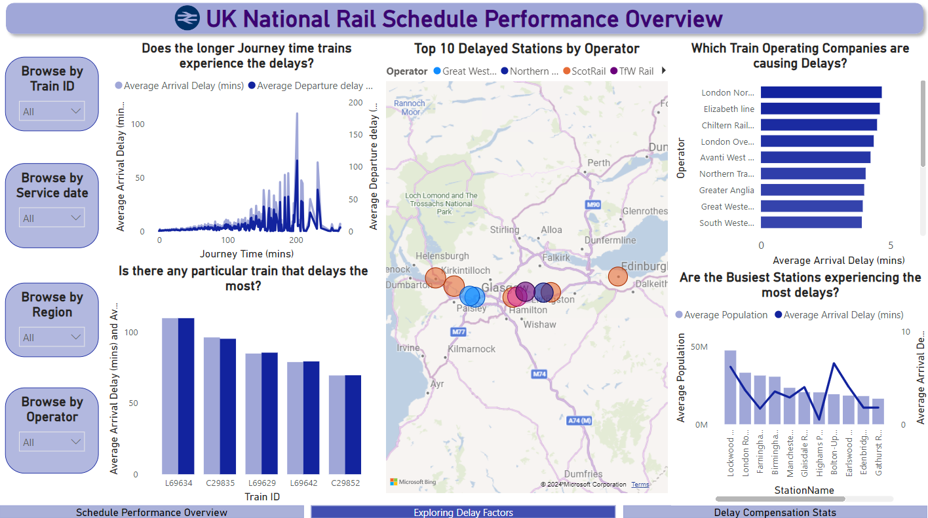
Approach and Insights
What are we going to answer?

Slide 14
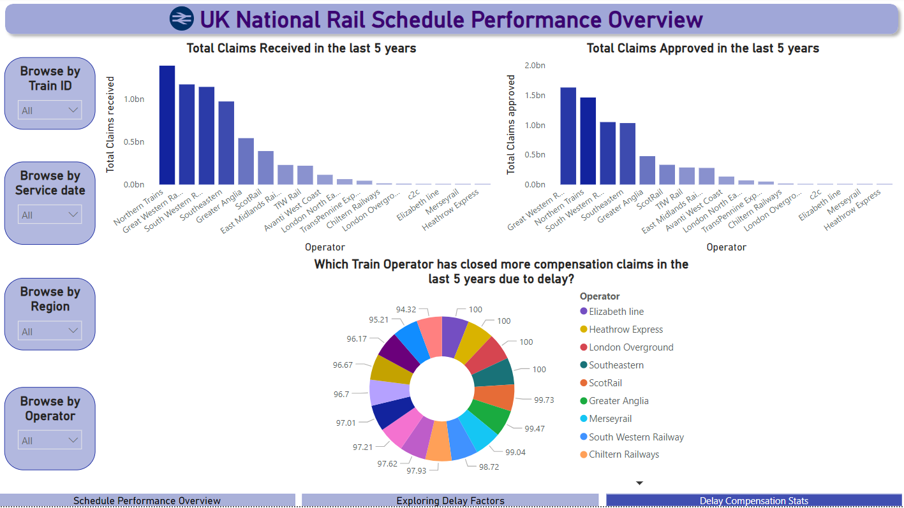
Approach and Insights
What are we going to answer?

Slide 15
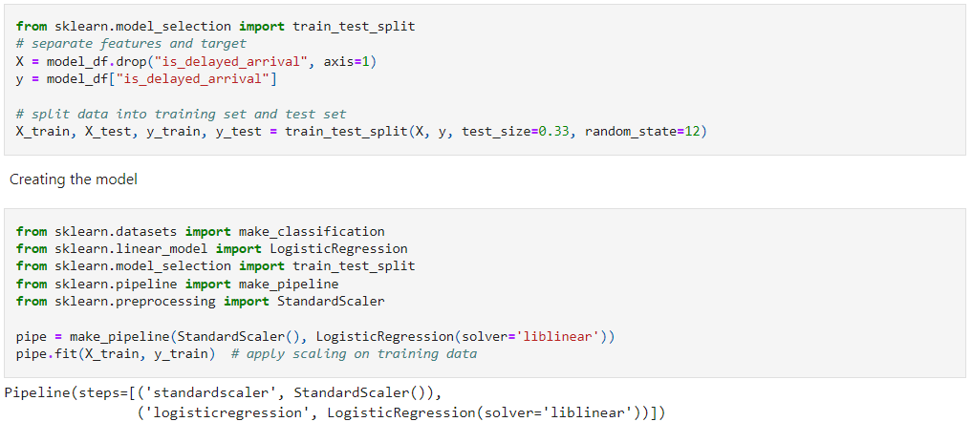
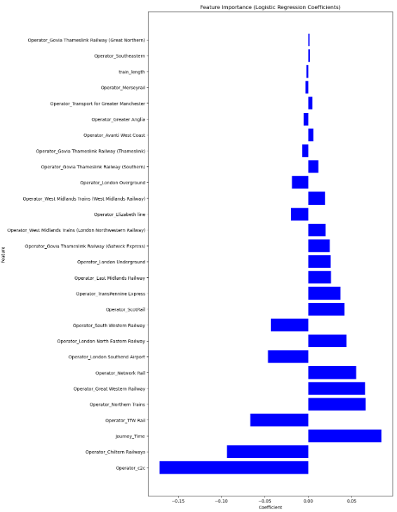
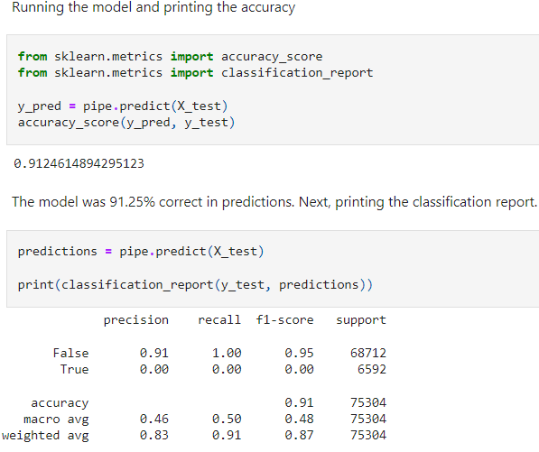
Approach and Insights
Can we predict if the train is going to be delayed?

Slide 16
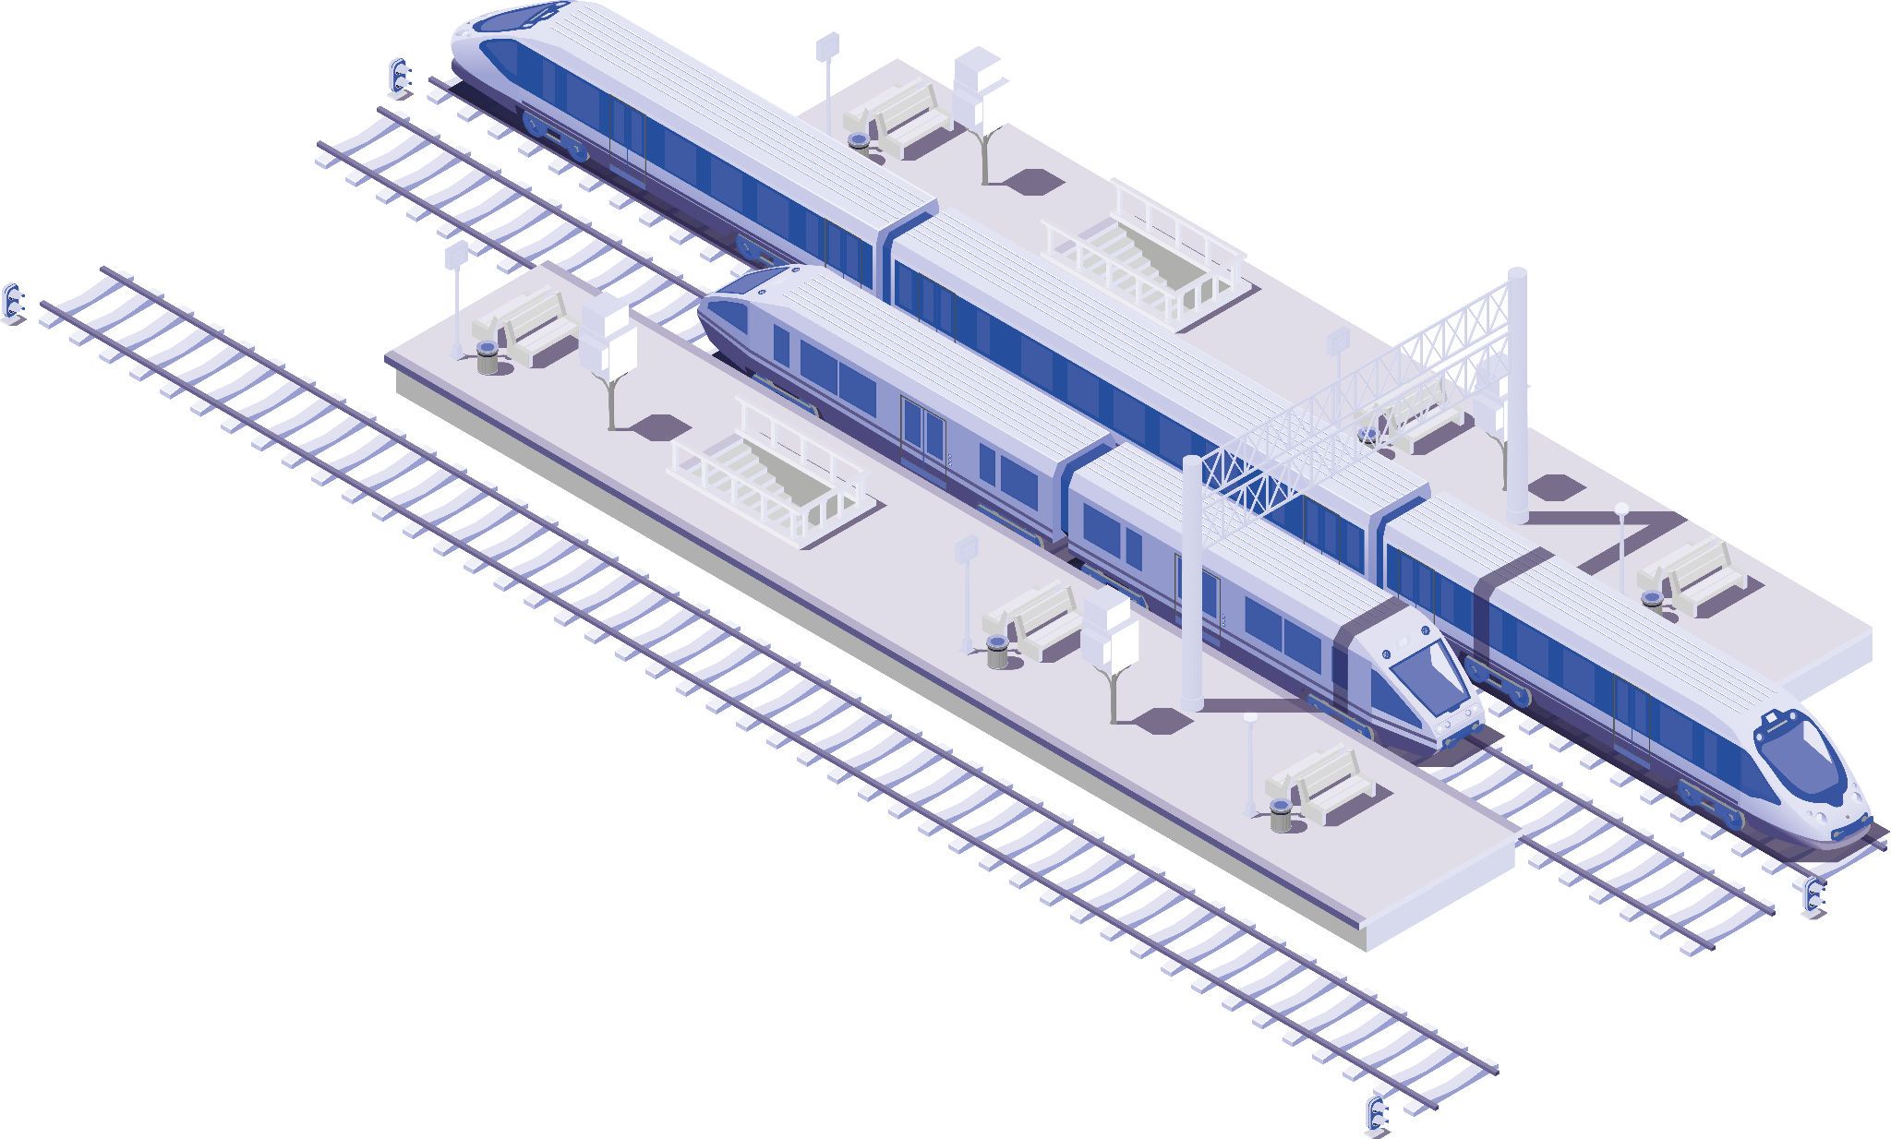
05
Key Insights
London stations are the most busiest train stations in UK.
UK Railways access by public showed steady growth since the last 2 decades until pre-pandemic.
Delay is observed around 8.7% , with an average delay of 39 minutes at midnight / early morning time of the day on alternate days of the week.
Train length is not influencing the delay as we expected which is validated from both correlation analysis and box plot.
Train Platforms UM in Chester-Le-Street and 15A in Leeds have shown to be the most delayed platforms with average delay above 34 mins.
Longer the journey, longer the delay is observed
The busiest stations are not the ones that is delayed more than a maximum of 10 minutes.
London North Eastern Railway TOC’s trains are the most delayed from our analysis
who has record of closing 96.7% of delay compensation claims in the last 5 years.
Journey time and few Operators are the most influencing factor in predicting the delay
of a scheduled train

Slide 17
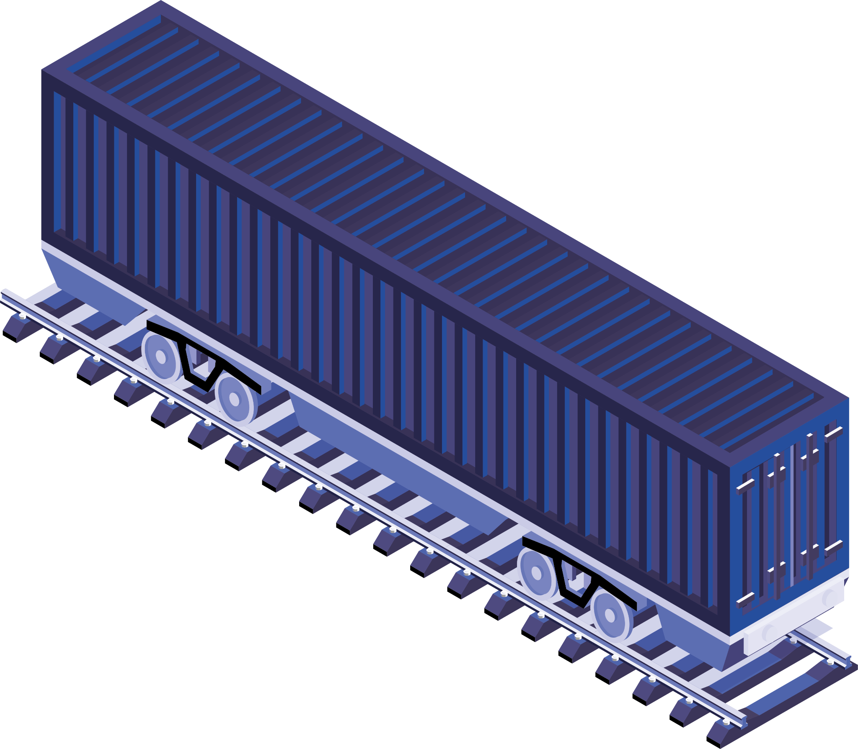
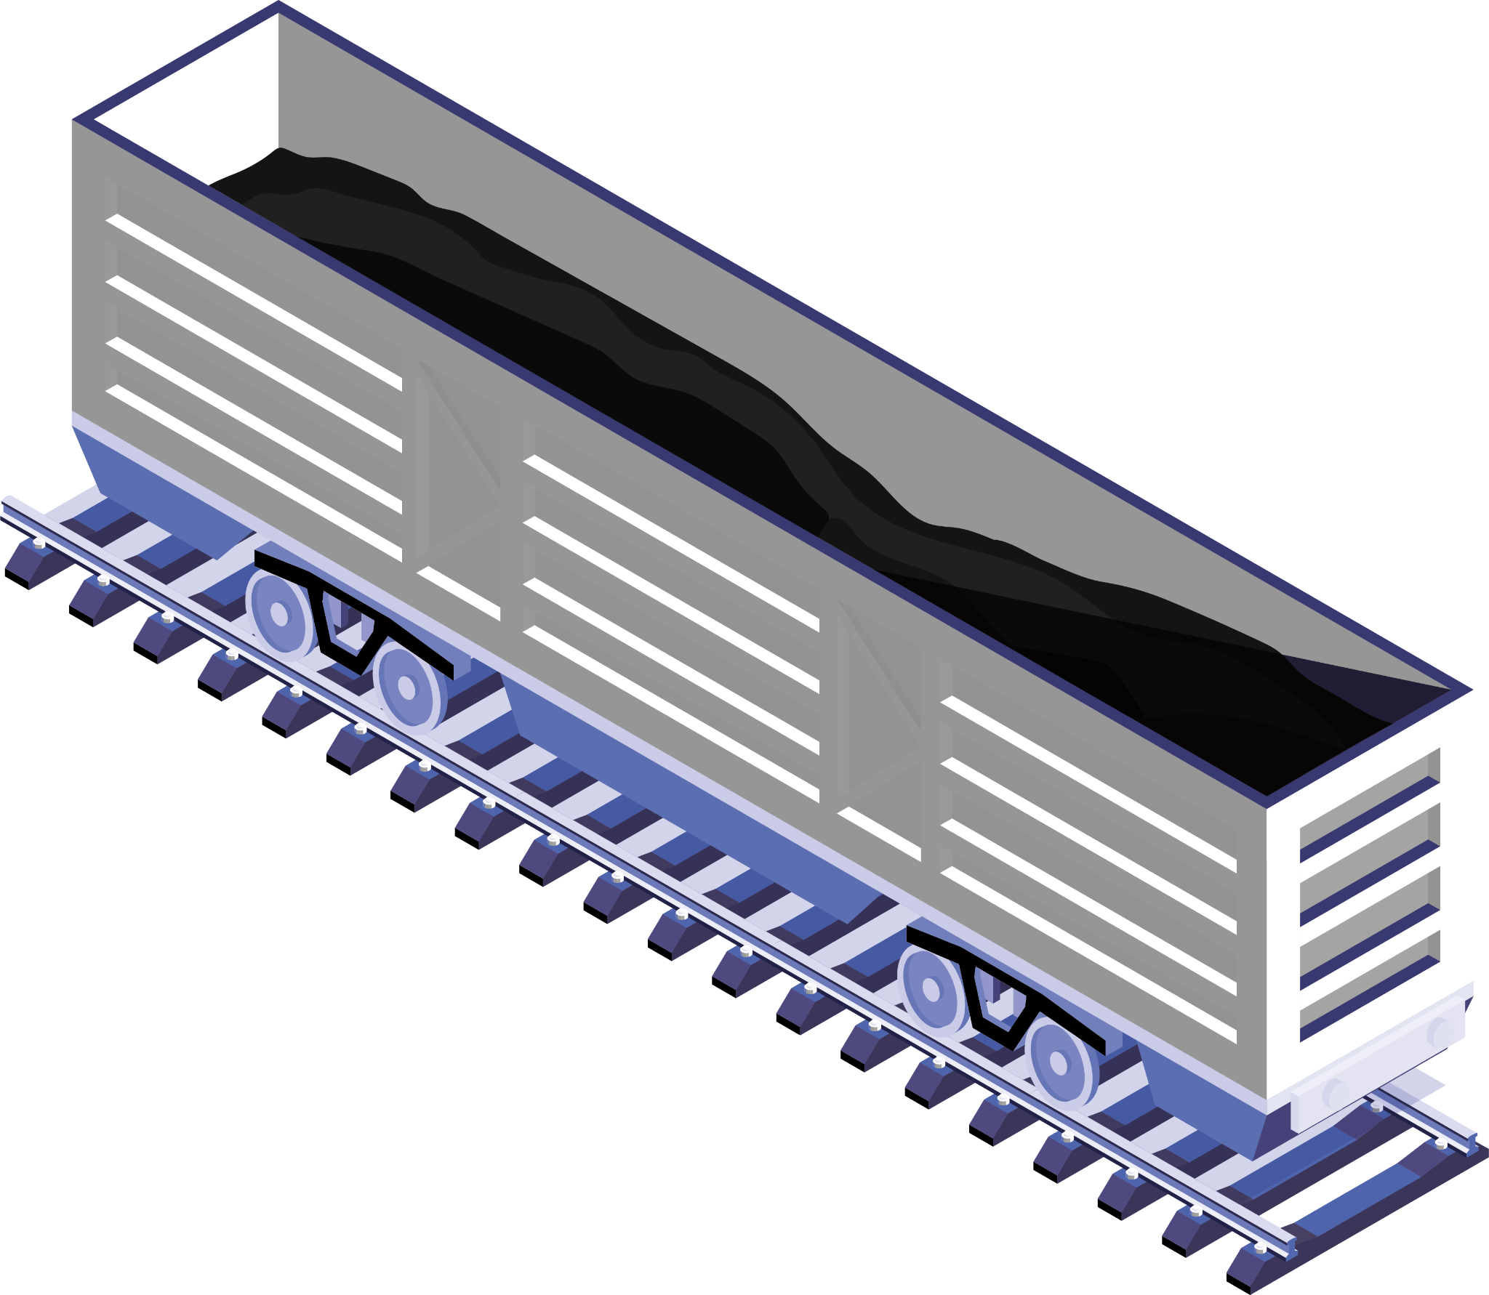
Acknowledgement
James Lee-Meredith, Instructor
Dylan Gleason, Teaching Assistant
William Westley, Program Manager
Grand Circus Team

Slide 18

Thanks!

